Slide 1

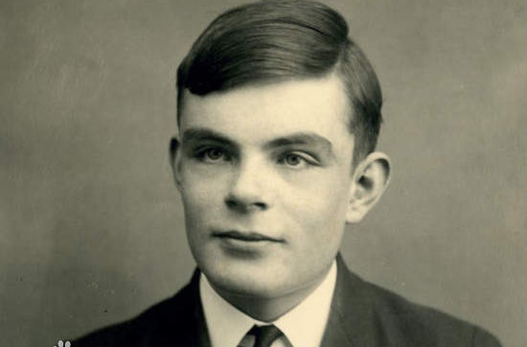
Alan Mathison Turing (1912-1954)

Slide 2

Can AI Replace Human Beings?
Team member: 李禹陈
黄裕清
江正阳

Slide 3
Outline
Fields that AI has replaced human
Fields that AI is replacing human
Fields that AI may replace human

Slide 4
1
Fields that AI has replaced human

Slide 5
A brief introduction
02
Computer Science
01
1956
03
Essential of Intelligencea
05
Developing
04
Wide-Range in Application

Slide 6
New “Job”
-competition predictor
1
Origin
In 2016, Alpha Go beat Lee Shishi
2
Developing
In many competitions, especially electronic sports competitions, commentators always ask the real-time judgement of AI for help
3
Result
Different judgement results in debate and progress.

Slide 7
Financial Institution
AI can arrange their property and investment accurately
01
03
02
AI has occupied most of customer service system
AI can discover abnormal situation quickly and make decisions

Slide 8
2
In what fields is AI coming？

Slide 9
在此输入标题
In translation
01
In medical
We can clearly see that today machine translation is much better than ten years ago due to AI, but it is worse than human today
We need translation because human have plenty of languages, no human can translate all of them and we need translation too much things.
AI which is Based on big data to make a diagnosis can replace doctor
02
04
03
In line up problem
In risk assiessment
Lots of fields will face line up problem, for example, traffic jam
Lots of successes on incomplete information game (like alpha star on Star craft II) persuade that AI can deal with risk assessment

Slide 10


在此输入标题
2017.4.10
Tomorrow？
01
02
AI Libratus Alan beats all of four professional sports.
Both are non-Complete information game.

Slide 11
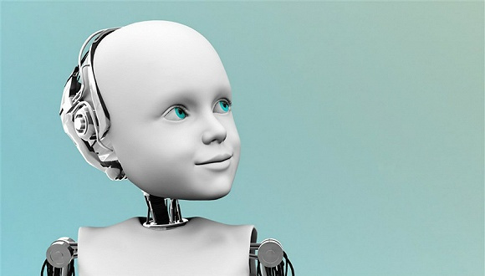
Can AI do everything Human can do？
From these facts, we can see that AI can do lots of things, include something maybe unbelievable.
Can AI do everything we can do？
Can AGI be come true？
Are there something AI must can not do？
AGI(artificial general intelligence), Such AI can do everything which human beings can do.

Slide 12
3
In the foreseeable future, What AI can't do?

Slide 13
In the foreseeable future, What AI can't do?
01
AI Can’t Multitask
AI Can’t Multitask
a. Most AI systems are highly trained to solve specific problems, AI is not quite capable of Generalization
b. Personal research experiences on training AI model
02
AI Can’t Always Explain Its Decisions
AI Can’t Always Explain Its Decisions
a. Some bad cases on image classifications
b. Adversarial Attacks on Neural Networks can deceive AI model
03
AI Can’t Feel Empathy Sympathy
AI Can’t Feel Empathy Sympathy, or Anything Else for That Matter
AI Can’t Feel Empathy Sympathy, or Anything Else for That Matter

Slide 14
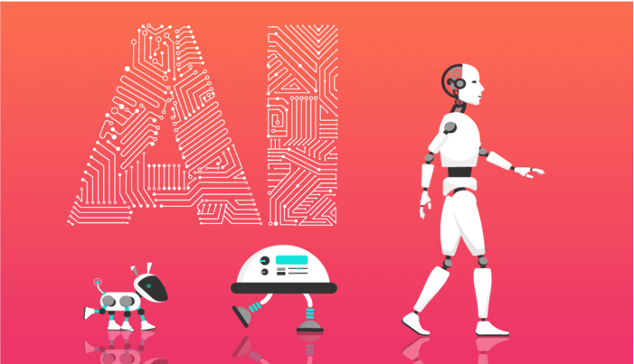
AI Can’t Multitask
“
Most AI systems are highly trained to solve specific problems, although AI innovators are trying to evolve the technology so that it can perform different types of tasks at once.
”

Slide 15
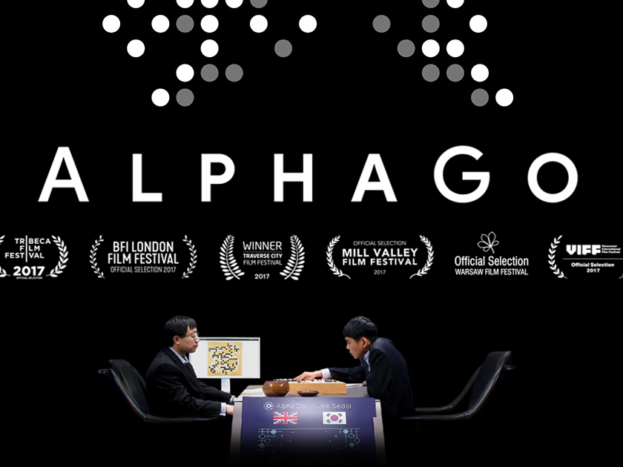
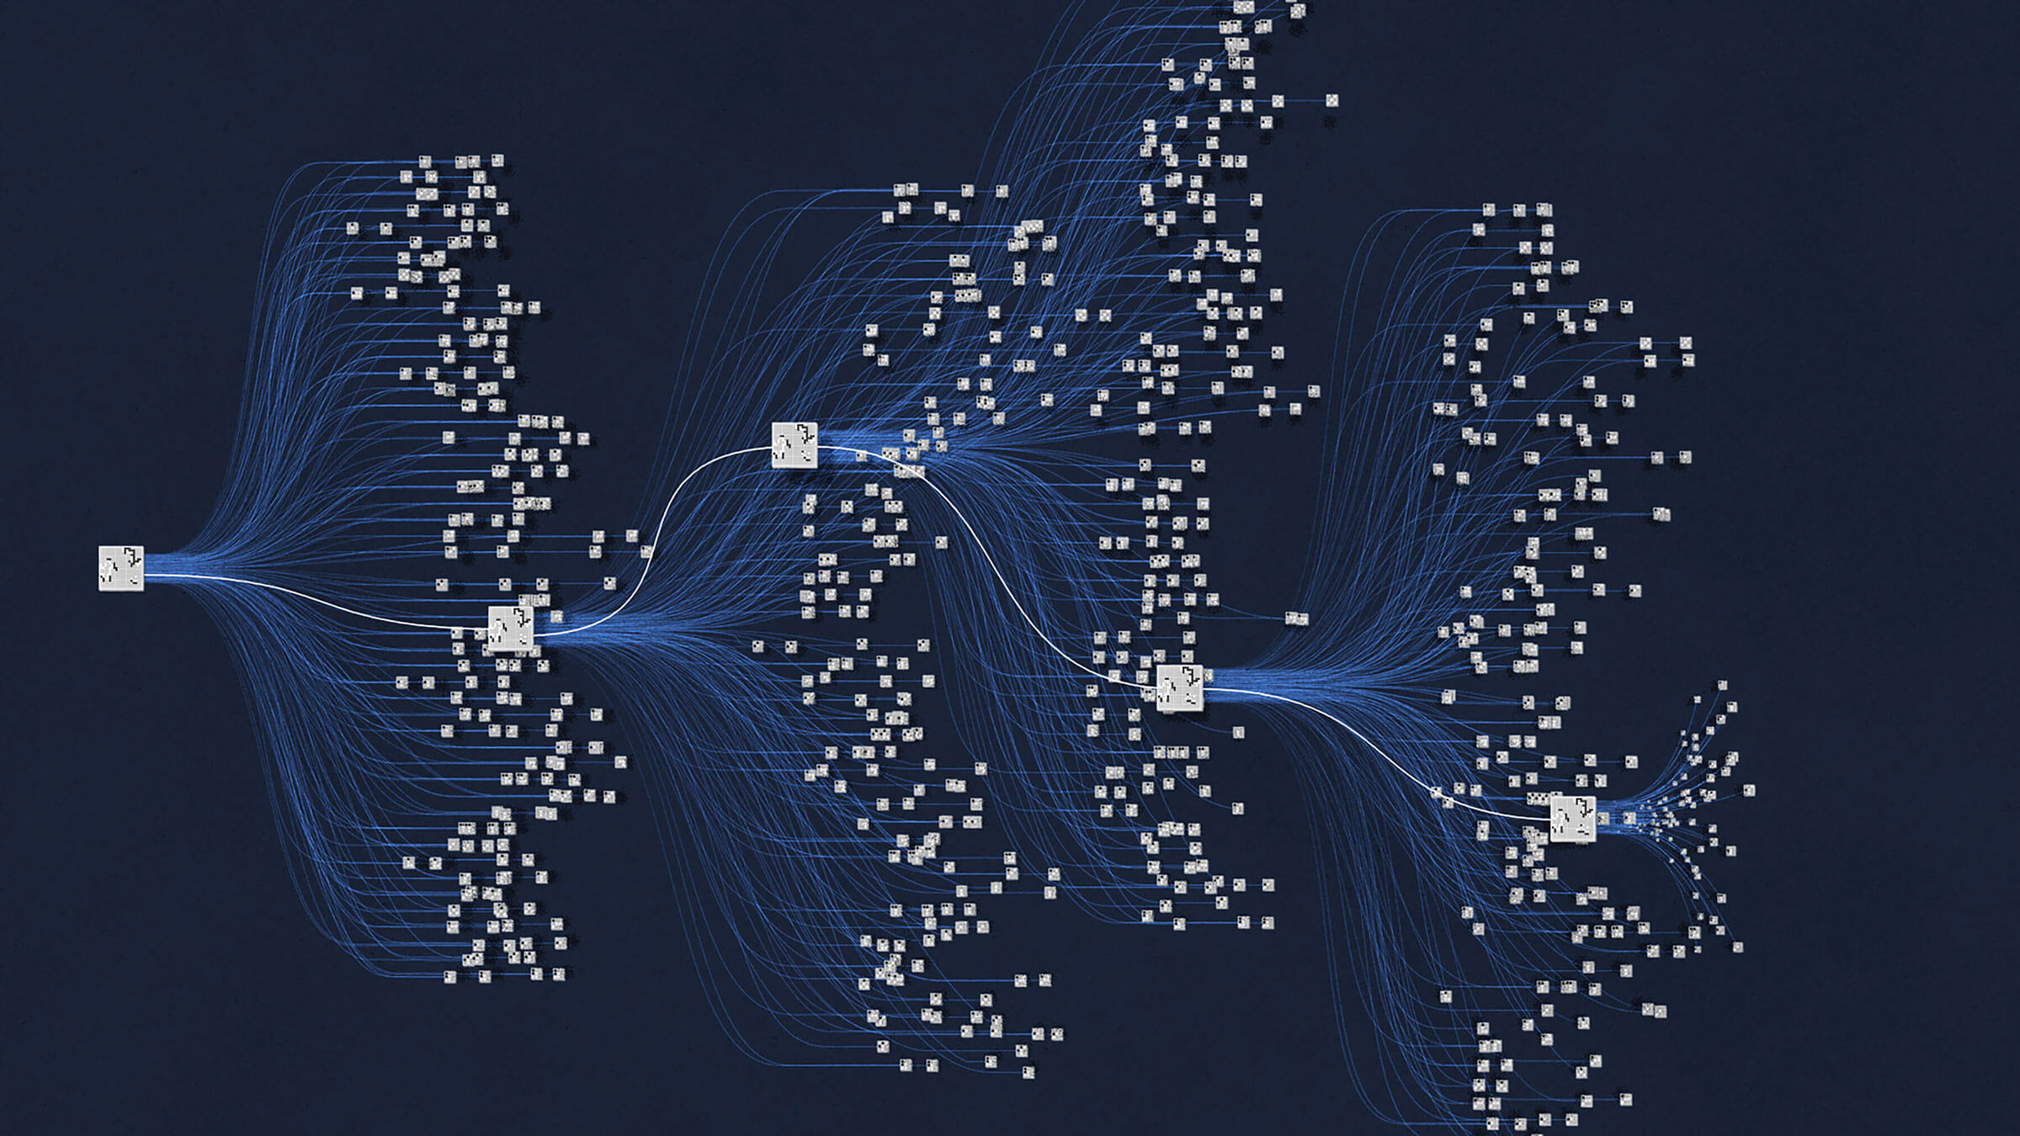
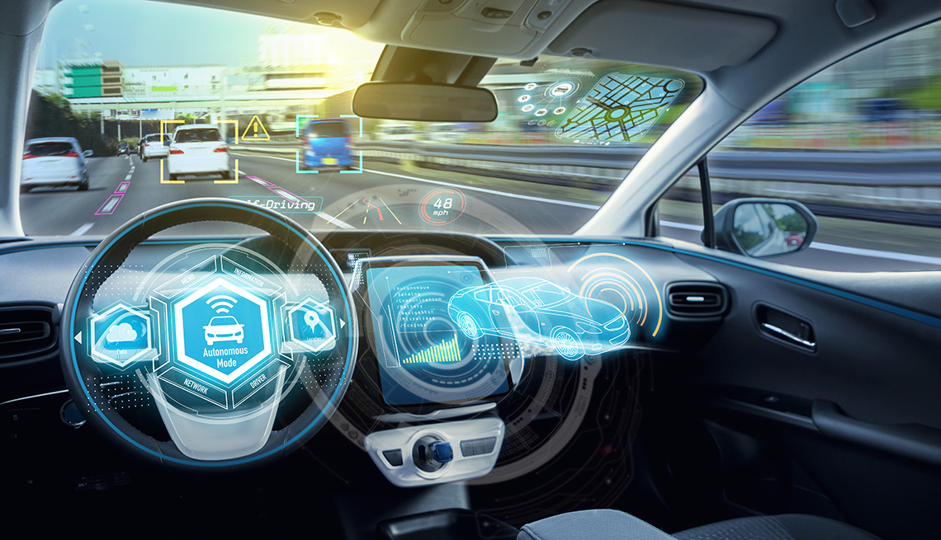
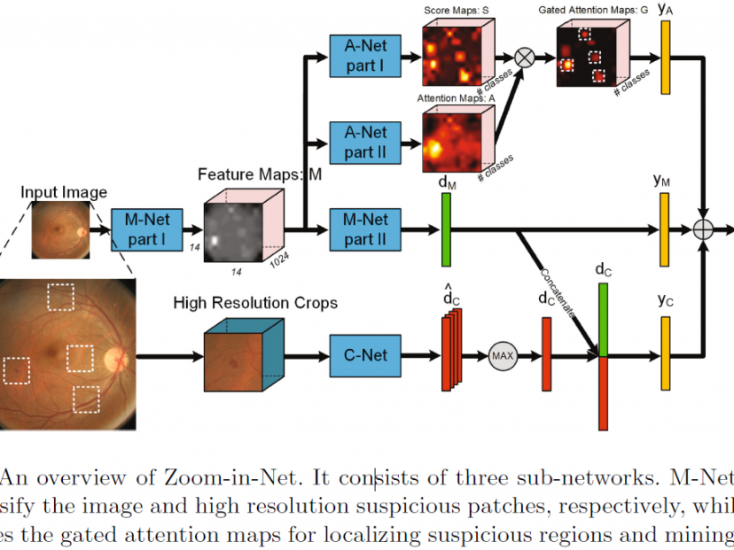
→

Slide 16
In the foreseeable future, What AI can't do?
01
AI Can’t Multitask
AI Can’t Multitask
a. Most AI systems are highly trained to solve specific problems, AI is not quite capable of Generalization
b. Personal research experiences on training AI model
02
AI Can’t Always Explain Its Decisions
AI Can’t Always Explain Its Decisions
a. Some bad cases on image classifications
b. Adversarial Attacks on Neural Networks can deceive AI model
03
AI Can’t Feel Empathy Sympathy
AI Can’t Feel Empathy Sympathy, or Anything Else for That Matter
AI Can’t Feel Empathy Sympathy, or Anything Else for That Matter

Slide 17
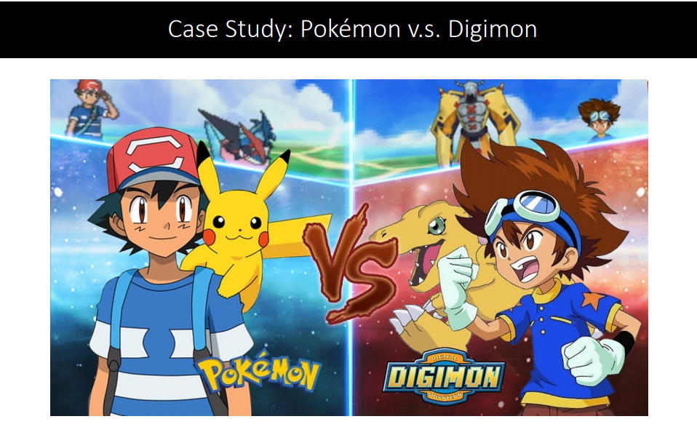
AI Can’t Always Explain Its Decisions
“
AI has an “explainability” problem. It provides answers and predictions based on the algorithms and data models that it uses to learn, but consumers of AI-powered products aren’t likely to know exactly what information the AI uses for decision-making.
”

Slide 18
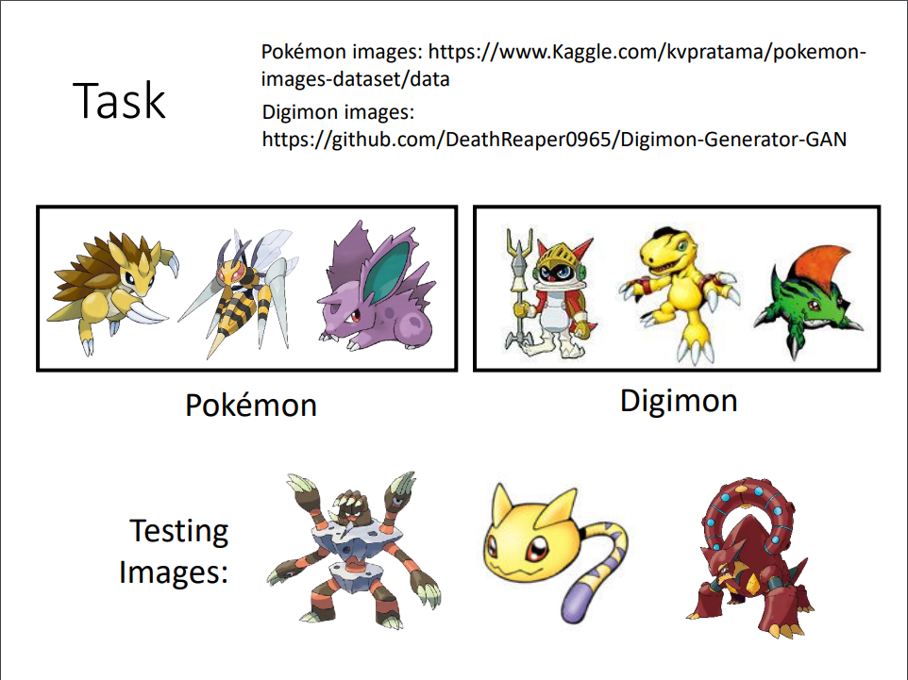

Slide 19
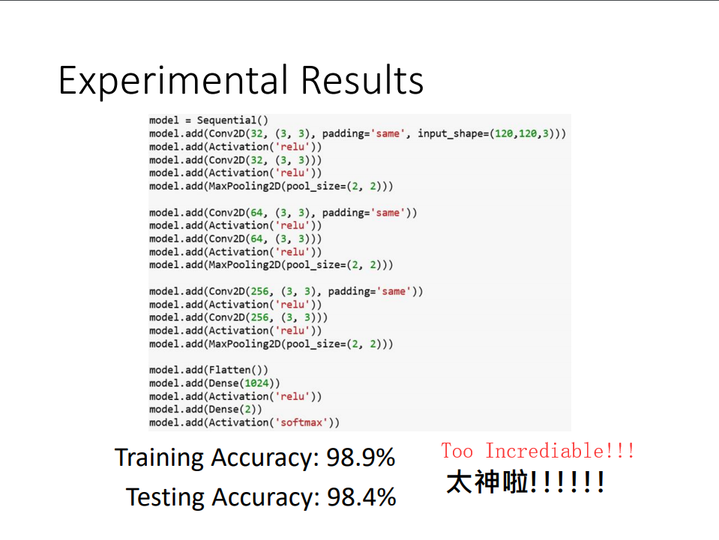

Slide 20
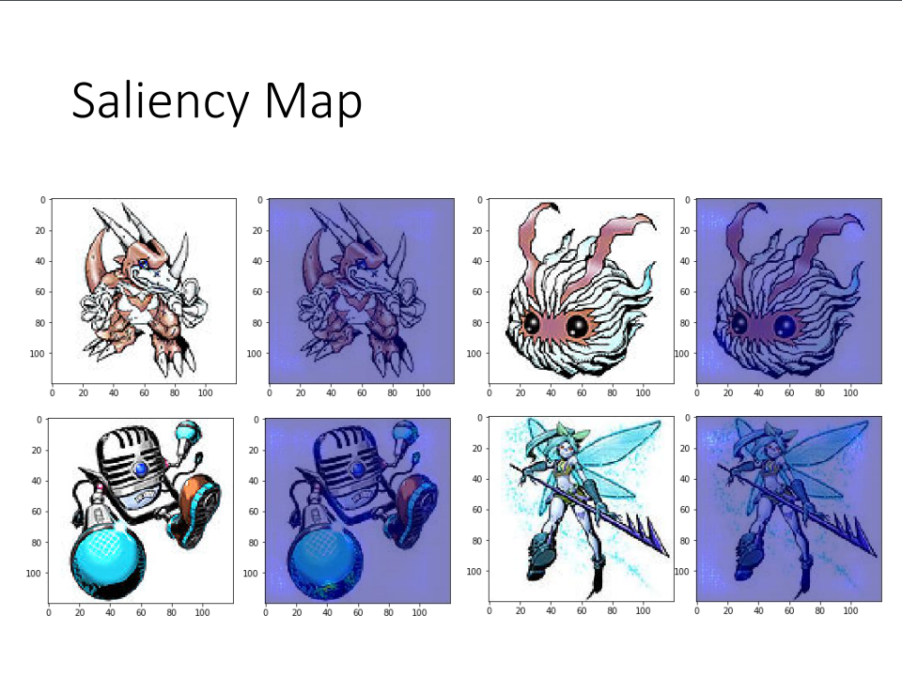
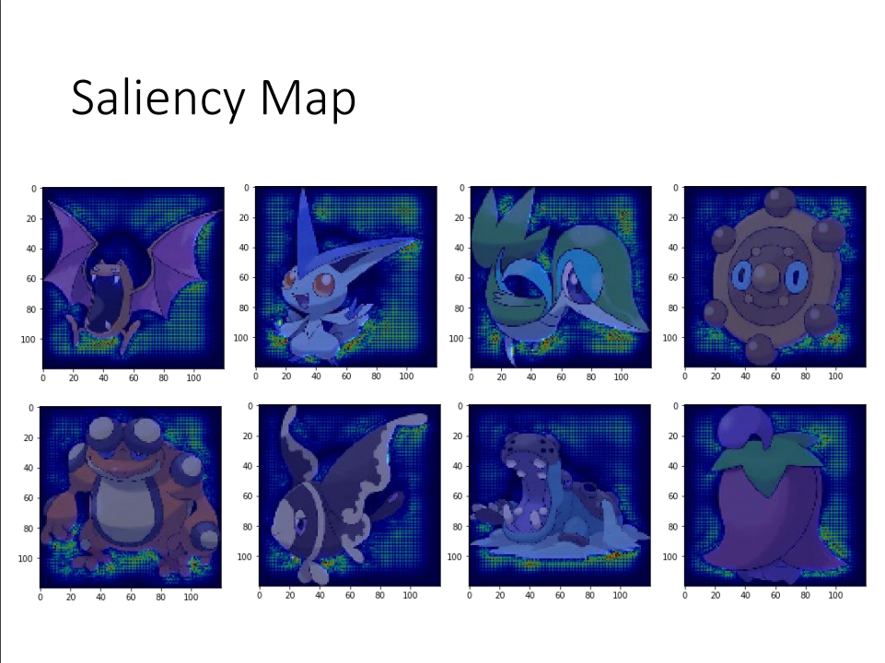

Slide 21
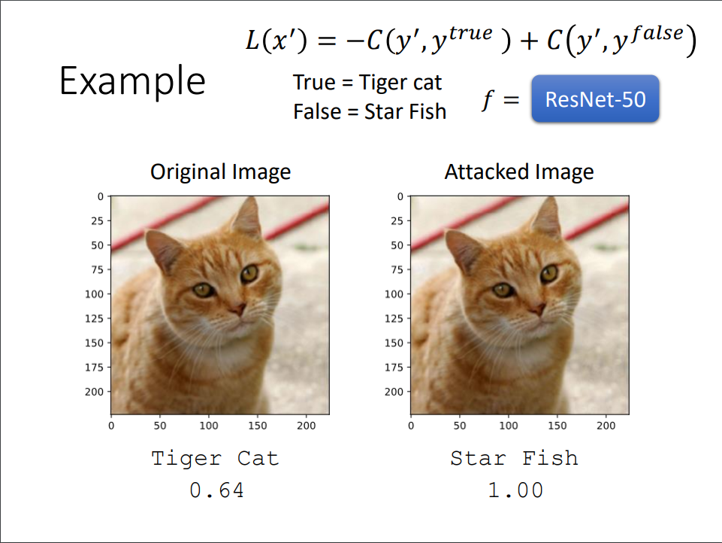
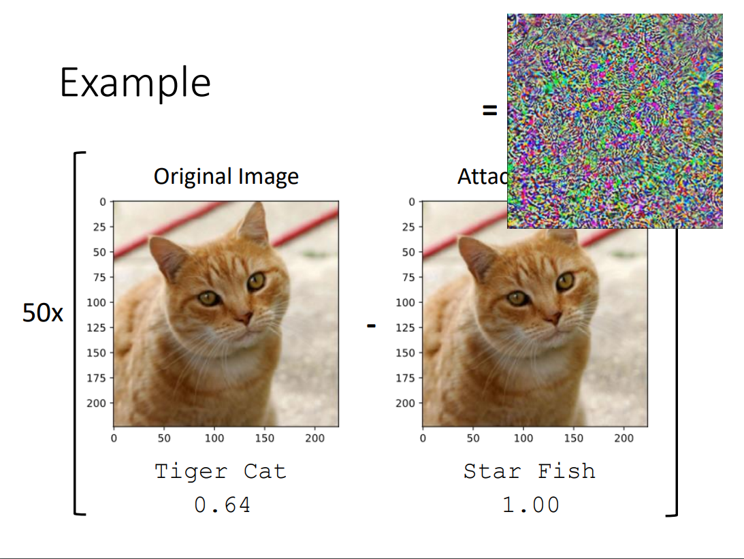
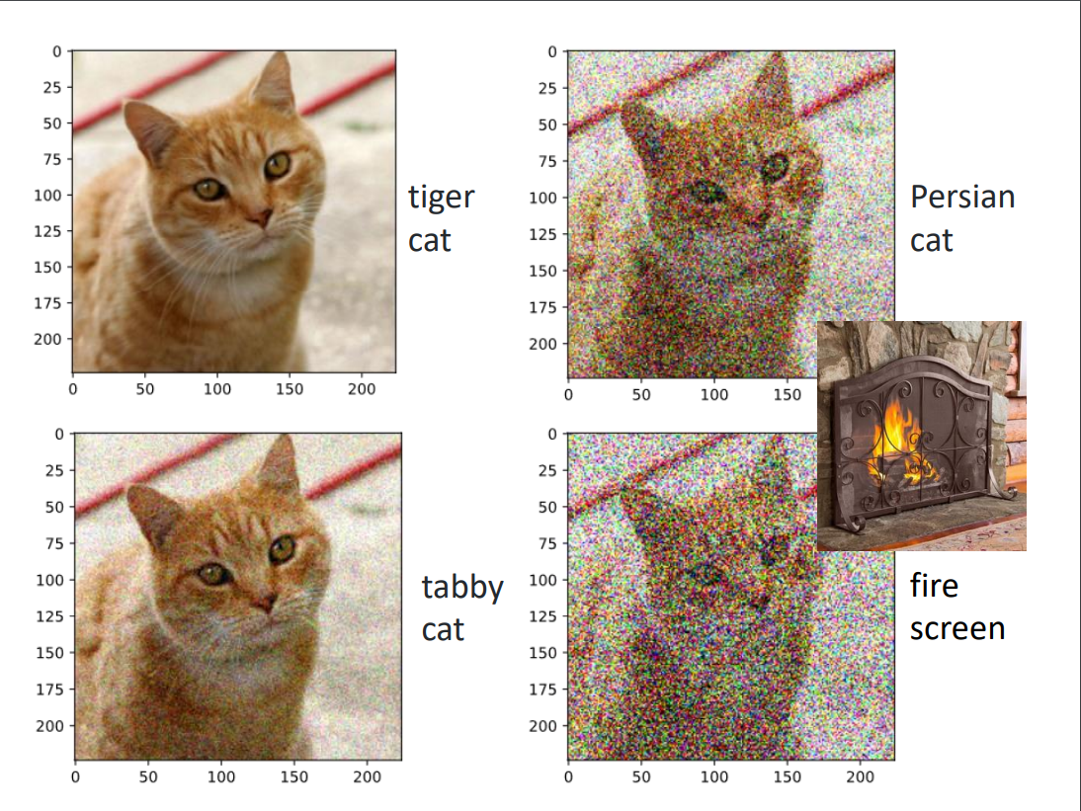
Adversarial Attacks on Neural Networks can deceive AI model

Slide 22
In the foreseeable future, What AI can't do?
01
AI Can’t Multitask
AI Can’t Multitask
a. Most AI systems are highly trained to solve specific problems, AI is not quite capable of Generalization
b. Personal research experiences on training AI model
02
AI Can’t Always Explain Its Decisions
AI Can’t Always Explain Its Decisions
a. Some bad cases on image classifications
b. Adversarial Attacks on Neural Networks can deceive AI model
03
AI Can’t Feel Empathy Sympathy
AI Can’t Feel Empathy Sympathy, or Anything Else for That Matter
AI Can’t Feel Empathy Sympathy, or Anything Else for That Matter

Slide 23
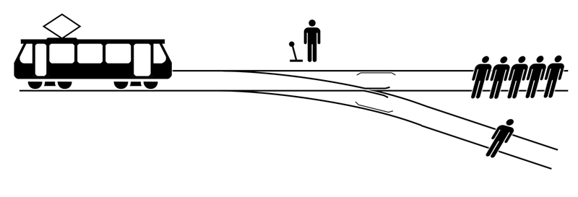
AI Can’t Feel Empathy Sympathy, or Anything Else for That Matter
When AI comes cross Trolley problem
“
What will Artificial Intelligence DO?
”

Slide 24
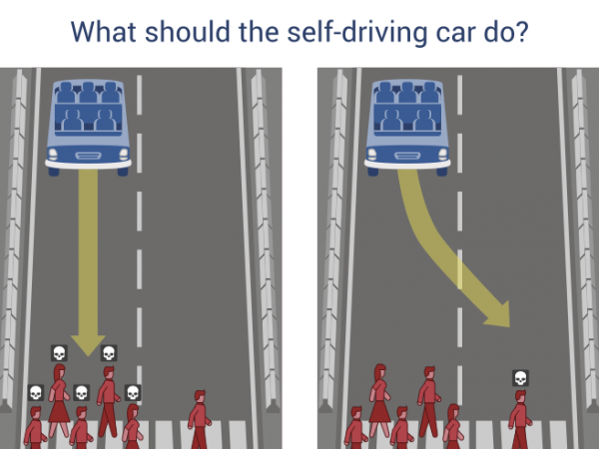
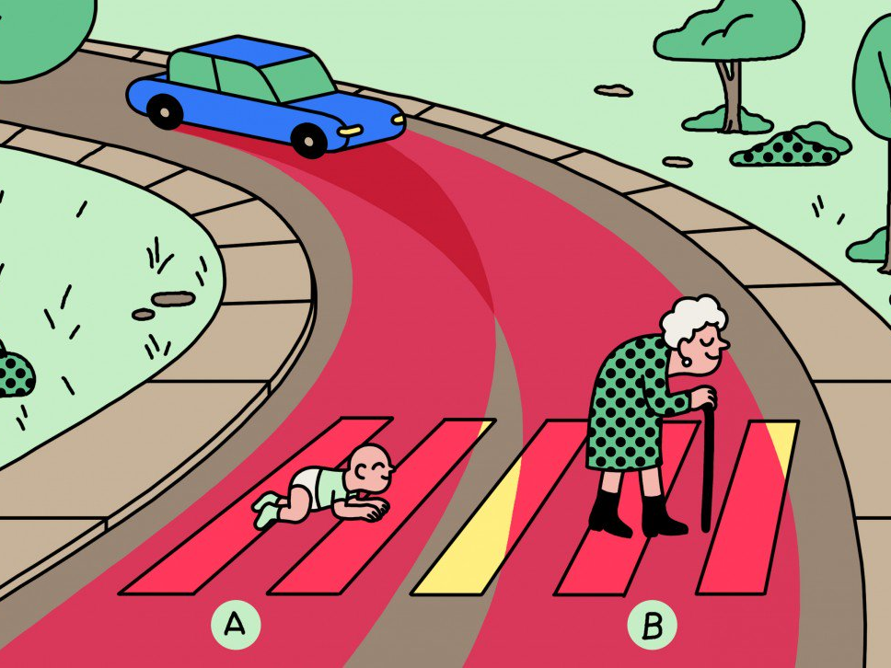

Slide 25
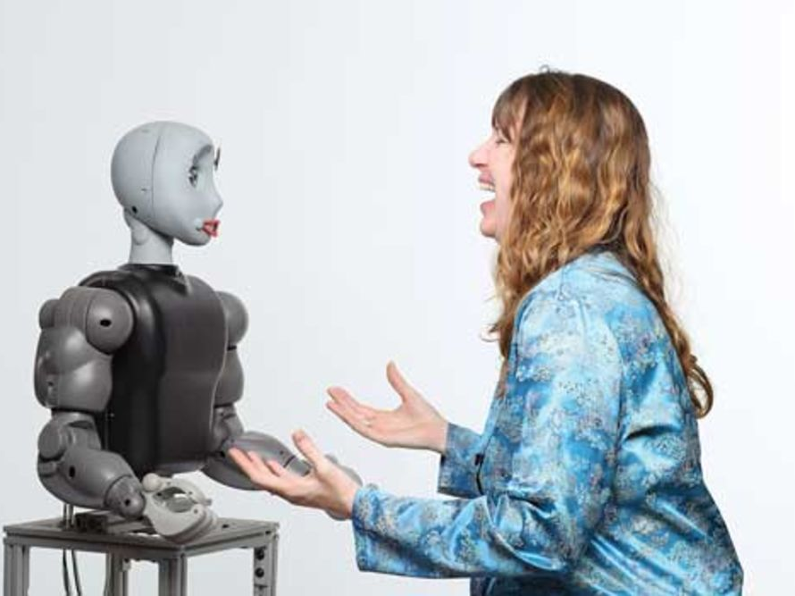
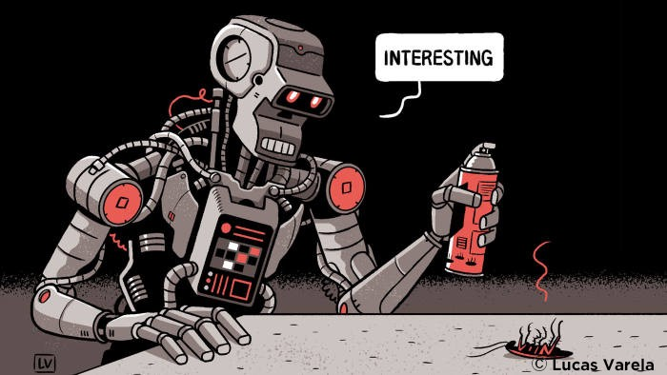
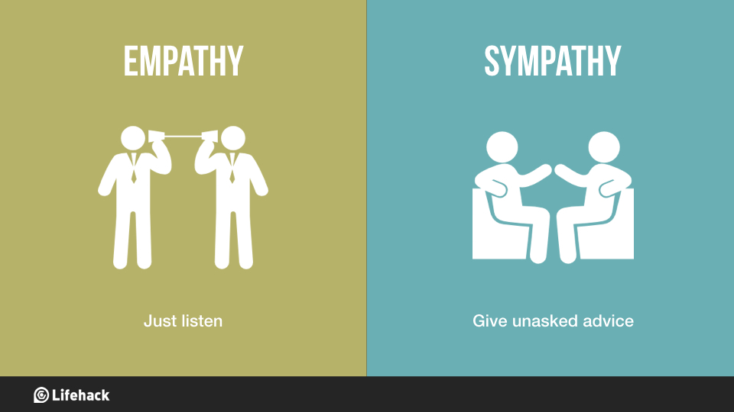
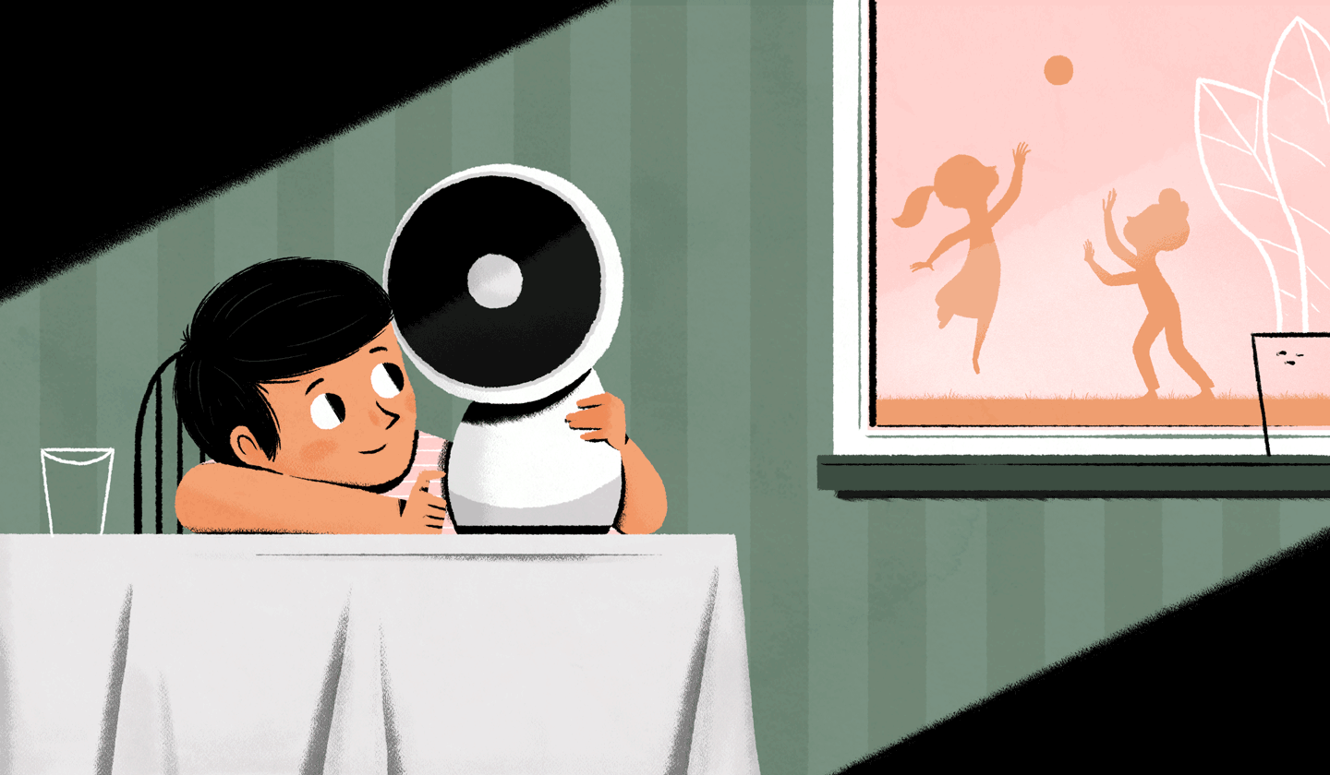
Empathy？
Sympathy？
Anything Else for That Matter？

Slide 26
4
Conclusion

Slide 27
Conclusion
AI is replacing human and can do better than human like Financial institutions and competition predictor.
01
03
02
But AI still have some limitations and have something it can’t do even in the foreseeable future.
In some basic work of scientific research, Ai can be a good partner for scientists.

Slide 28
Thanks for your listening

Slide 29
Q&A

